Slide 1
The Pyramid Principle
Logic in Thinking and Writing
http://intergon.freeyellow.com

Slide 2
Document Structure
Introduction
  Situation
  Complication
  Question/Answer (Solution)
Body
Next Steps
  Something the readers will not question if they buy your argument
Conclusion
  Summary/Call to action/Emotion provocation
http://intergon.freeyellow.com
Notes:
ALWAYS INCLUDE SLIDE NUMBER (USE THIS TO SECTION TO WRITE YOUR SCRIPT)

Slide 3
Introduction
Reminds rather than informs
Only what the reader will agree is true, plus your answer
  S--Your current system is X.
  C--It does not work.
  Q--How should it be changed?
  A--You need to….
http://intergon.freeyellow.com

Slide 4
Another example
S--Your organization is growing rapidly.
C--Your HR processes are not keeping up with your growth.
Q--What should be done?
A--You should…..
http://intergon.freeyellow.com

Slide 5
Creating an introduction
1. Draw a box and write down subject.
2. Decide the question the reader wants answered.
3. Write down the answer.
4. Describe the situation without controversy.
5. Develop the complication--Answer “so what”.
6. Recheck the question and the answer.
http://intergon.freeyellow.com

Slide 6
Creating an introduction
4
5
2
6
3
1
http://intergon.freeyellow.com
Notes:
This numbering correlates to previous slide , no.5

Slide 7
Body
Controlling the sequence in which you present your ideas is the single most important way to make your presentation clear
  Ideas at any level must be summaries of ideas grouped below them
  Ideas in each grouping must always be of the same kind
  Ideas in each grouping must be logically ordered
http://intergon.freeyellow.com

Slide 8
Ideas can be grouped inductively or deductively
Inductive Logic
Deductive Logic
http://intergon.freeyellow.com
Notes:
This explains from slide no.7
Deductive logic means is a type of deduction used in science and in life. It is when you take two true statements, or premises, to form a conclusion. For example, A is equal to B. B is also equal to C. Given those two statements, you can conclude A is equal to C using deductive reasoning.
In inductive reasoning, you use inductive logic to draw a causal link between a premise and hypothesis. As an example: In the summer, there are ducks on our pond. Therefore, summer will bring ducks to our pond
A premise is a statement in an argument that provides reason or support for the conclusion. There can be one or many premises in a single argument. A conclusion is a statement in an argument that indicates of what the arguer is trying to convince the reader/listener.

Slide 9
Japanese escalating drive for Chinese market
  Deductive: That Americans are doing the same thing is sure to stimulate the Japanese further
    Second point makes a comment on the first
  Inductive: Americans are escalating drive for Chinese market
    Second point is another of the same type
http://intergon.freeyellow.com

Slide 10
Argument first
You must change
WHY?
HOW?
What’s wrong?
What’s causing it?
Here’s what you should do
A1
B1
C1
A2
B2
C2
A3
B3
C3
http://intergon.freeyellow.com
Notes:
You will see how this relates to developing proper skills in doing research. If you do not have the proper reasoning, you cannot arrive to a true knowledge and you cannot argue well.

Slide 11
Action first
You must change
HOW?
A3
B3
C3
WHY?
A2 A1 B2 B1 C2 C1
http://intergon.freeyellow.com

Slide 12
If you can’t find the order in the grouping, your thinking has a flaw.
Deductive reasoning
Chronology
Structure
Comparison/classification/ranking
http://intergon.freeyellow.com
Notes:
Hence why this is tied to logical thinking and that is demonstrated in how well you do research.

Slide 13
Poor Chronology
Strategic planning involves the recognition of a timing cycle
  Perception of need
  Development of strategy for creating responsive product/service
  Implementation
  Market acceptance and high growth
  Slower growth/the onset of maturity
  High cash generation
  Decline/decay
http://intergon.freeyellow.com

Slide 14
Structure
The objectives for the assignment as we understand them are:
  To review and analyze field operations in maintenance and construction
  To determine if adequate organizational and managerial flexibility exists to allow field engineers to properly respond to day-to-day operating problems and demands
  To review and analyze the areas of preliminary engineering, road and bridge design, environmental process, right-of-way acquisition and traffic management
  To review and analyze the organization structure of the Department
  To identify the strengths and weaknesses within each study area
http://intergon.freeyellow.com

Slide 15
Classification
The causes of New York’s decline are many and complex. Among them are:
  Wage rates higher than those that prevail elsewhere in the country
  High energy, rent and land costs
  Traffic congestion that forces up transportation costs
  A lack of modern factory space
  High taxes
  Technological change
  The competition of new centers of economic concentration in the Southwest and West
  The refocusing of American economic and social life in the suburbs
http://intergon.freeyellow.com
Notes:
Not properly classified, some belong to the same classification (see read font, they overlap and could be better classified)

Slide 16
Better classification
New York’s decline is because of better alternatives elsewhere
  New York is a high-cost city in which to do business
  More attractive areas are springing up in the Southwest and West
  Thus, when companies face the need to move, they choose to go south or west
http://intergon.freeyellow.com
Notes:
A good demonstration of learning is the ability to classify

Slide 17
Summary statements must show implications
If there is no relationship, you end up with intellectually vapid assertions
  You should have three objectives
  There are two problems
  We recommend five changes
http://intergon.freeyellow.com

Slide 18
Each type of grouping has a clear method of summarizing
Summarize action ideas by stating effect of carrying out actions
Summarize situation ideas by stating what is implied by their similarity
Summarize deductive arguments by leaning on the deduction
http://intergon.freeyellow.com

Slide 19
A summary that means nothing
Identify high-potential profit-improvement projects
  Review background data
    Define your key task
    Collect data for the key task
    Review events and trends affecting the key task
  Identify possible projects
    Measure profit impact of improved performance
    Assess possible level of improvement and profit impact
    Prepare a draft Profit-Improvement Project Plan
http://intergon.freeyellow.com

Slide 20
A summary you can visualize
To prepare a draft profit-improvement plan:
  Identify a possible project
    Select an operating activity where cost and investment are high
    Look for evidence of poor performance
    Measure profit impact of correcting poor performance
  State the implications of pursuing the project
    Determine the probable level of improvement
    Estimate resource requirements to undertake project
    Work out a timetable
http://intergon.freeyellow.com

Slide 21
I have a dream
Dreams include:
  Sons of former slaves and slave owners sitting together
  Character replacing skin color
  Black and white children holding hands
  Black men equal to white men
Freedom is scheduled to ring in:
  New York, Mississippi, Georgia; Alabama, Tennessee, California
http://intergon.freeyellow.com

Slide 22
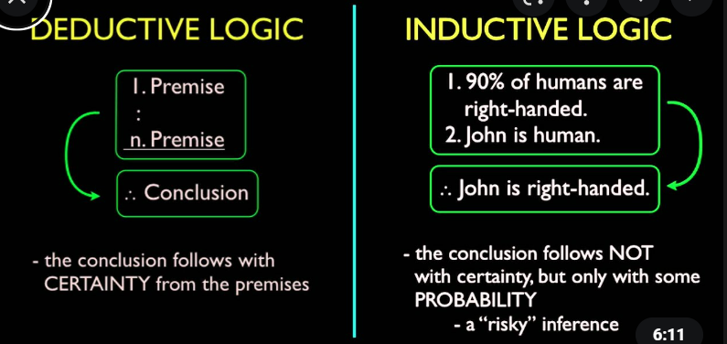
This is just a note to show deductive vs inductive logic
http://intergon.freeyellow.com

